Slide 1
Research Progress
Relation-Level Structural Analysis of Predictive Multiplicity
in Knowledge Graph Embedding for Link Prediction
知識グラフ埋め込みにおける予測多重性をもたらす
関係レベル構造要因の解明
M2+ 趙 怡名
Notes:
Today I will present my current research progress.
The title is “Relation-Level Structural Analysis of Predictive Multiplicity in Knowledge Graph Embedding for Link Prediction.”
The main goal of this work is to understand whether predictive multiplicity in KGE link prediction is related to relation-level structural factors.

Slide 2
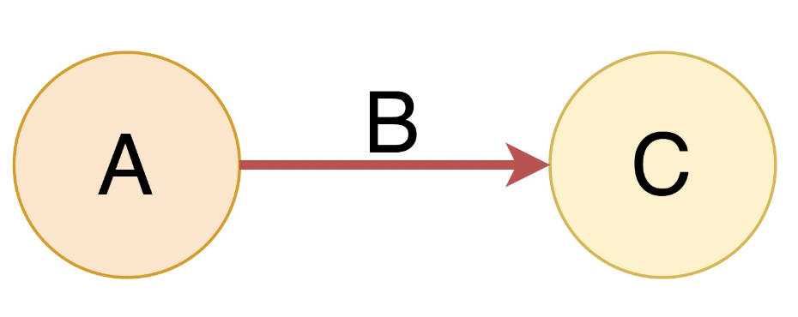
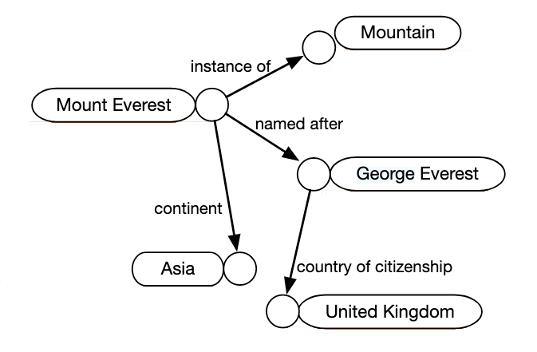



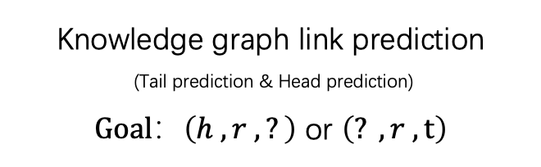
Background: Knowledge graph embedding link prediction
A: head entity B: relation C: tail entity
Knowledge graph link prediction (Tail prediction & Head prediction)
$Goal：\left(h , r , ?\right)$ or $\left(? , r , t\right)$
Triple
(Paris, capital_of , ? )
Two possible ranking outcomes
Ranking | Entity
1 | France
2 | Germany
3 | Italy
… | …
10 | Spain
11 | China
… | …
Ranking | Entity
1 | Germany
2 | Spain
3 | Italy
… | …
10 | China
11 | France
… | …
$$Hit@10$$
$$Miss@10$$
Example of Knowledge graph^{[1]}
Evaluation metric: $Hits@10$
The proportion of test queries for which
this top-10 success condition is satisfied.
Notes:
Before introducing predictive multiplicity, I will first briefly explain the basic task of KGE link prediction.
A knowledge graph represents facts as triples. Each triple consists of a head entity, a relation, and a tail entity. Since different triples can share entities, many triples together form a knowledge graph.
In link prediction, the input is usually an incomplete query, such as (h, r, ?) or (?, r, t).
KGE models learn embeddings for entities and relations. Based on these embeddings, the model scores candidate triples and ranks all candidate entities.
For example, for the query (Paris, capital_of, ?), the model scores all candidate tail entities and produces a ranking.
If the correct answer appears in the top 10, we count this query as a Hit@10. If the correct answer is ranked outside the top 10, we count it as a Miss@10.
Hits@10 is the proportion of test queries where this top-10 success condition is satisfied.
在开始讲 predictive multiplicity 之前，我先简单说明一下 KGE link prediction 的基本任务。 知识图谱把事实表示为三元组，也就是 head、relation、tail。由于不同三元组之间会共享实体，许多三元组连接起来之后，就构成了一个知识图谱。
在 link prediction 任务中，我们通常输入一个不完整的 query，例如 (h, r, ?) 或者 (?, r, t)。 KGE 的做法是为实体和关系学习 embedding，并据此对候选三元组进行打分。然后，模型会对所有候选实体进行排序。
例如，对于 (Paris, capital_of, ?) 这样的 query，模型会对所有候选 tail entity 打分并生成一个排序结果。 如果正确答案出现在前 10 个候选里，我们就记这个 query 为一个 hit@10；如果正确答案排在第 10 名之外，就记为 miss@10。 而 Hits@10 指的就是：在所有测试 query 中，hit@10 所占的比例。
我这里先特别说明 Hits@10，是因为后面要讲的 predictive multiplicity，本质上关注的是：对于同一个 query，在不同 repeated runs 下，它的 top-10 hit / miss 判定是否会发生变化。

Slide 3
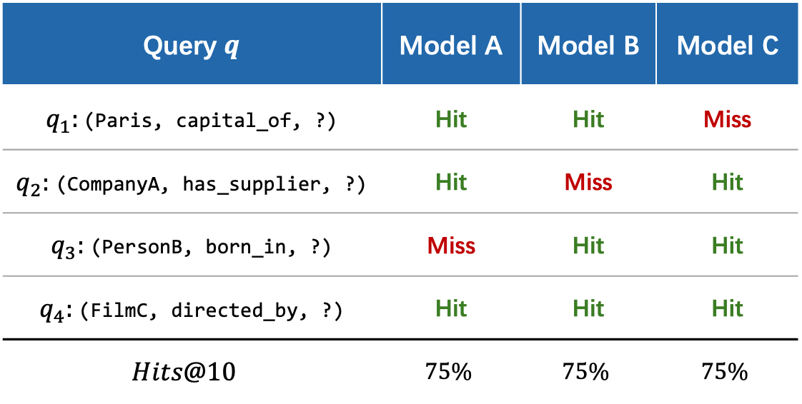
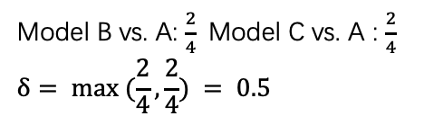

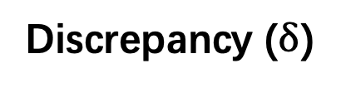
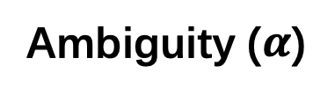
Prior Work: Predictive Multiplicity
Predictive multiplicity^{[2]}
Ambiguity ($α$)
Even when models have similar overall performance, they may still disagree on whether a specific query is a top-K hit or miss.
This phenomenon is quantified by ambiguity and discrepancy.
Measures how many queries are unstable across similarly performing models.
（Among all test queries, how many receive at least one conflicting decision?）
Here: $α= \frac{3}{4} = 0.75$
Toy Example: Same Overall Performance with Query-Level Disagreement
Query $q$ | Model A | Model B | Model C
$q_{1}$: (Paris, capital_of, ?) | Hit | Hit | Miss
$q_{2}$: (CompanyA, has_supplier, ?) | Hit | Miss | Hit
$q_{3}$: (PersonB, born_in, ?) | Miss | Hit | Hit
$q_{4}$: (FilmC, directed_by, ?) | Hit | Hit | Hit
$$Hits@10$$ | $$75\%$$ | $$75\%$$ | $$75\%$$
Discrepancy ($δ$)
Measures the worst-case disagreement rate between the baseline and one competing model.
（For one competing model, how large can the overall disagreement rate be? ）
Here:
Model B vs. A: $\frac{2}{4}$Model C vs. A : $\frac{2}{4}$
$$δ= max (\frac{2}{4},\frac{2}{4}) = 0.5$$
Key idea of multiplicity
Similar overall performance does not imply identical query-level decisions.
Notes:
Based on that, we can ask the following question: if we train the same KGE model family multiple times with different random seeds, will these models always give the same top-K hit or miss decision for the same test query?
Predictive multiplicity refers to this kind of query-level instability.
In other words, even when several models have very similar overall performance, they may still disagree on the top-K hit or miss decision for a specific query.
The important point here is not that the overall accuracy is very different. The important point is that similar overall performance does not necessarily mean identical query-level decisions.
To make this more concrete, I show a toy example here.
Suppose we have three repeated runs: Model A, Model B, and Model C. They use the same model setting, but different random seeds.
At the bottom of the table, we can see that all three models have the same overall accuriccy which is 75%.
So, if we only look at the aggregate evaluation metric, their performance is exactly the same.
However, if we look at the hit or miss decision for each test query, we can see that they are not always consistent.
For example, in the first query, Model A and Model B give Hit, but Model C gives Miss. So this query has a conflicting top-K decision. The same kind of conflict also appears in the second and third queries. Only the fourth query is stable, because all three models give Hit. This shows that even when overall Hits@10 is the same, the model decisions for individual queries can still be unstable. The original paper uses two metrics to quantify this predictive multiplicity: ambiguity and discrepancy. First, ambiguity is denoted by alpha. Ambiguity asks: among all test queries, how many queries receive at least one conflicting top-K decision? In this toy example, three out of four queries have at least one conflict. So the ambiguity is 3 divided by 4, which is 0.75. In short, alpha measures how many queries are unstable. Next, discrepancy is denoted by delta. Discrepancy looks at the model side. It asks: for one competing model, how large can the overall disagreement rate be compared with the baseline model? Here, if we use Model A as the baseline, Model B disagrees with Model A on two queries. So the disagreement rate between Model B and Model A is 2 divided by 4. Model C also disagrees with Model A on two queries. So the disagreement rate between Model C and Model A is also 2 divided by 4. Therefore, delta is the maximum of these values, which is max(2/4, 2/4) = 0.5. So ambiguity and discrepancy both describe predictive multiplicity, but they focus on different aspects. Ambiguity focuses on the query side: how many queries are unstable. Discrepancy focuses on the model side: how much one competing model can disagree with the baseline model. The key idea of this slide is that similar overall performance does not imply identical query-level decisions. If link prediction is used in downstream decision-making, this can become a serious issue. In that case, the final conclusion may depend on random training variation, rather than stable relational evidence in the graph. So, even with the same model family and similar overall performance, different random seeds may lead to different top-K decisions for the same query.
在上一页里，我先介绍
了 KGE link prediction 和 Hits@10。
在这个基础上，我们进一步考虑一个问题：如果对同一个 KGE model family，用不同随机种子进行 repeated runs，那么这些模型对同一个 test query 的 top-K hit / miss 判定，会不会始终一致？
Predictive multiplicity 讨论的就是这种 query-level 的不稳定性。
也就是说，即使几个模型的整体表现非常接近，它们对于某一个具体 query，仍然可能在 top-K hit / miss decision 上出现分歧。 这里的重点不是模型整体 accuracy 差很多，而是：overall performance similar，并不意味着 query-level decision 也一定相同。
为了更直观地说明这一点，我这里放了一个 toy example。
这里假设我们有三个 repeated runs，分别是 Model A、Model B 和 Model C。 它们来自同一个模型设定，只是随机种子不同。这里设定 K = 10，所以如果正确答案被排在前 10 名以内，就记为 Hit；如果排在第 10 名之外，就记为 Miss。
从表格最下面可以看到，这三个模型的整体 Hits@10 都是 75%。 也就是说，如果只看整体评价指标，它们的表现是完全一样的。
但是，当我们进一步看每一个 test pair 的 hit / miss decision 时，就会发现它们并不一致。
比如第一个 test pair，Model A 和 Model B 都给出了 Hit，但 Model C 给出了 Miss。 第二个 test pair 中，Model A 和 Model C 是 Hit，而 Model B 是 Miss。 第三个 test pair 中，Model A 是 Miss，而 Model B 和 Model C 是 Hit。 只有第四个 test pair 上，三个模型都一致给出了 Hit。
这说明，即使 overall Hits@10 完全一样，模型在具体 query 上的判断也可能是不稳定的。
接下来，原论文用两个指标来量化这种 predictive multiplicity，也就是 ambiguity 和 discrepancy。
首先是 ambiguity，记作 alpha。
Ambiguity 关注的是：在所有 test pairs 中，有多少 test pair 至少出现过一次 conflicting top-K decision。 换句话说，只要对于某一个 test pair，存在一个 similarly performing model 和 baseline model 的 Hit / Miss 判断不同，那么这个 test pair 就被认为是 ambiguous。
在这个 toy example 里，四个 test pairs 中，前三个都出现了 hit / miss 冲突，只有第四个没有冲突。 所以这里的 ambiguity 是 3/4，也就是 0.75。
也就是说，alpha 衡量的是：有多少 query 是不稳定的，或者说 multiplicity 覆盖了多大范围的 test queries。
然后是 discrepancy，记作 delta。
Discrepancy 关注的不是“有多少 query 曾经发生过冲突”，而是从模型角度看：对于某一个 competing model，它和 baseline model 之间，整体最多可以分歧到什么程度。
在这里，如果我们把 Model A 作为 baseline，那么 Model B 和 Model A 在第二、第三个 test pair 上判断不同，所以 disagreement rate 是 2/4。 Model C 和 Model A 在第一、第三个 test pair 上判断不同，所以 disagreement rate 也是 2/4。 因此 delta 就是两者中的最大值，也就是 max(2/4, 2/4) = 0.5。
所以，ambiguity 和 discrepancy 虽然都在描述 multiplicity，但它们的侧重点不同。
Ambiguity 更关注 query side：有多少 test pairs 是不稳定的。 Discrepancy 更关注 model side：某一个 competing model 最多能和 baseline model 分歧到什么程度。
这一页最重要的 takeaway 是： Similar overall performance does not imply identical query-level decisions.
如果 KGE link prediction 的结果被用于下游决策，那么这个问题就会变得更加严重。 因为在这种情况下，最终结论可能并不是由 graph 中稳定的 relational evidence 决定的，而是会受到 random training variation 的影响。 也就是说，仅仅因为随机种子不同，一个整体表现相近的模型就可能对同一个 query 给出不同的 top-K decision。

Slide 4
Research Focus: From Prior Work to Thesis Question
Original paper
Formalizes predictive multiplicity in KGE link prediction
Introduces ambiguity and discrepancy as evaluation metrics
Shows that multiplicity exists empirically, and voting can mitigate it
My thesis question
The original paper establishes the existence of predictive multiplicity in KGE link prediction.
My thesis extends this line of inquiry by asking whether predictive multiplicity is systematically associated with relation-level structure.
Accordingly, the focus shifts from a global phenomenon to relation-level analysis.
Main question: Which relation-level factors are associated with stronger predictive multiplicity?
Notes:
So far, we have seen what predictive multiplicity is and how it is measured.
Next, I will explain what the original paper mainly addressed, and how my thesis question extends from it.
The original paper has three main contributions.
First, it formally defines predictive multiplicity in KGE link prediction.
Second, it introduces two metrics, ambiguity and discrepancy, which we just discussed.
Third, it empirically shows that predictive multiplicity exists, and that voting can reduce it to some extent.
However, for my thesis, I see the original paper as mainly answering the question of whether this phenomenon exists.
My current interest is a different question: does this multiplicity behave differently across different relations?
Therefore, my thesis moves from a global observation of the phenomenon to a relation-level analysis.
More specifically, I want to study which relation-level factors are associated with stronger or weaker predictive multiplicity.
到这里为止，我们已经知道了 predictive multiplicity 是什么，以及它是如何被定义和衡量的。 那接下来我想先说明一下：原论文本身主要解决到了哪里，而我自己的 thesis 问题又是从哪里接上的。
原论文的核心贡献，概括来说有三点。 第一，它把 predictive multiplicity 这个现象正式定义到了 KGE link prediction 里。 第二，它提出了两个衡量指标，也就是我们刚才看到的 ambiguity 和 discrepancy。 第三，它通过实验说明：这种 multiplicity 现象在经验上确实存在，而且可以通过 voting 在一定程度上缓解。
但是，对我来说，原论文更像是回答了一个 “现象是否存在” 的问题。 而我现在更关心的是另一个问题：这种 multiplicity 现象，是否会在不同 relation 上表现出系统性的差异。
所以，我当前 thesis 的工作重点，就从原论文中更偏整体性的现象观察，进一步推进到了 relation-level analysis。 更具体地说，我想研究的是：哪些 relation-level 的因素，会和更强或者更弱的 predictive multiplicity 相关。

Slide 5
Method: Thesis Setting and Relation-Level Analysis Pipeline
Thesis setting
Dataset: FB15k-237
Models: RotatE^{[3]} and TransE^{[4]}
Repeated runs of the same model family
Analysis unit: relation-level rather than only dataset-level/global-level
FB15k-237: a standard KGE benchmark with less inverse-relation leakage than FB15k, making it more suitable for structural analysis of link prediction.
RotatE / TransE: two representative KGE models used here as a focused cross-model comparison under the current thesis scope.
Pipeline
Run repeated training with different random seeds
Compute query-level top-10 hit / miss outcomes
Aggregate them into relation-level metrics
Attach relation-level factors
Compare which factors are associated with stronger multiplicity
Notes:
I explain my thesis setting and the overall analysis pipeline.
The current study uses FB15k-237, and focuses on two representative KGE models: RotatE and TransE.
FB15k-237 reduces inverse-relation leakage compared with the original FB15k, so it is suitable for structural analysis in link prediction.
I train the same model family multiple times with different random seeds, and analyze raw predictive multiplicity before applying any voting method.
The analysis unit is relation-level. I compute Hits@10, alpha, and delta for each relation, and then attach relation-level factors such as mapping property, inverse-like support, symmetry, and relation frequency.
Finally, I compare which factors are associated with stronger multiplicity.
So, the goal is not mitigation at this stage. The goal is to identify where multiplicity becomes more serious, and which relation structures are more important.
这一页我说明一下我当前 thesis 的具体设定，以及整体分析流程。
我的研究范围是相对收窄的。当前主线主要固定在 FB15k-237 这个数据集上，模型主要看 RotatE 和 TransE。
这里我也简单说明一下为什么当前设定固定在 FB15k-237、RotatE 和 TransE。 FB15k-237 是一个很常用的 KGE benchmark，而且相对于早期的 FB15k，它专门处理了 inverse-relation leakage 的问题，所以更适合做 link prediction 下的结构分析。 模型方面，我现在聚焦在 RotatE 和 TransE，主要是把 thesis 设定收窄到一个可控范围内，同时也保留一个跨模型比较：也就是主结果不是只在一个模型上成立，而是至少在这两个代表性模型上都做检查。 另外，我关注的是同一模型 family 在不同随机种子下的 repeated runs，也就是先看 raw multiplicity，而不是先引入 voting 去缓解它。
在分析单位上，我当前不把重点放在整个数据集的一个全局平均值上，而是进一步推进到 relation-level。 也就是说，我希望对每一个 relation 分别观察它的 multiplicity 表现，然后再比较不同 relation 之间是否存在系统差异。
整体流程上，可以概括为五步。 首先，基于 repeated runs 得到 query-level 的 top-10 hit / miss 结果。 然后，把这些 query-level 结果聚合成 relation-level 指标，也就是 hits_r、alpha_r 和 delta_r。 接着，再为每个 relation 附加不同的 relation-level factor，例如 mapping type、inverse-like support、symmetry 和 relation frequency。 最后，再去比较：哪些因素会和更强的 predictive multiplicity 相关。
所以从 thesis 的角度来说，我当前的目标并不是提出一个新的 mitigation method，而是想解释：multiplicity 在什么地方更严重，以及哪些 relation structure 更值得关注。

Slide 6


Method: Candidate Relation-Level Factors
Selection principle
Predictive multiplicity is a top-K ranking instability.
I therefore focus on relation-level factors that may affect answer-space ambiguity, structural support, or data sparsity.
1. Mapping property
3. Symmetry
How many distinct heads/tails are typically associated with a relation.
Whether $(h,r,t)$is often supported by $(t,r,h)$ under the same relation.
Typical categories
$1−1$, $1−N$, $M−1$, $M−N$
(one-to-one, one-to-many, many-to-one, many-to-many)
Intuition
Intuition
Internal bidirectional evidence may provide consistent signals for the same entity pair and affect ranking stability.
Changes the number of plausible candidates on the prediction side. When the prediction side is the many-side, the top-K boundary may become less stable.
Example
Example
married_to
adjacent_to
has_capital: closer to 1-1
has_child: closer to 1-N
born_in: closer to M-1
language_spoken_in: closer to M-N
4. Relation frequency (support/ sparsity factor)
2. Inverse
How often a relation appears in the training graph.
Whether a relation has a clear reverse partner.
Control question
Intuition
Reverse-side evidence may constrain prediction behavior and make repeated runs more consistent.
Is multiplicity caused by relation structure, or simply by data sparsity?
Example
Role
parent_of $⇔$child_of
capital_of $⇔$has_capital
Support / sparsity control.
Notes:
Next, I explain the candidate relation-level factors used in this analysis.
The basic idea is simple: predictive multiplicity is a top-K ranking instability, so I focus on relation-level factors that may affect the stability of the top-K ranking.
In short, these factors cover three aspects: answer-space ambiguity, structural support, and data sparsity.
The first factor is mapping property.
It describes how many heads and tails are typically associated with a relation. The common categories are 1-to-1, 1-to-N, M-to-1, and M-to-N.
This factor is important because it directly changes the size of the candidate answer space on the prediction side.
For example, in tail prediction, if the relation is 1-to-N, the same head-relation pair may have many plausible tail candidates. In that case, the top-K boundary can become less stable.
This is why mapping property is likely to be related to predictive multiplicity, and its effect may depend on the prediction side.
The second factor is inverse-like support.
It asks whether a relation has a clear reverse partner, such as parent_of and child_of. If such reverse-side evidence exists, it may constrain prediction behavior and make repeated runs more consistent.
The third factor is symmetry.
This is different from inverse. Symmetry looks at bidirectional support inside the same relation, such as married_to or adjacent_to.
The fourth factor is relation frequency.
I use it as a support and sparsity control. It helps check whether the observed structural effects are really caused by relation structure, or simply by limited training data.
So these four factors are selected to test whether predictive multiplicity is associated with answer-space structure, reverse support, internal bidirectional support, or data sparsity.
接下来，我说明一下在 relation-level analysis 中，我选择了哪些 candidate factors，以及为什么选择这些因素。
这里的出发点是：predictive multiplicity 本质上是一种 top-K ranking instability。 也就是说，我们关注的不是模型能不能输出某个具体实体，而是正确答案在 repeated runs 之下，是否能够稳定地留在 top-K 里面。
所以，我选择 relation-level factors 的标准是：这些因素是否可能影响 top-K ranking 的稳定性。 更具体地说，我主要关注三类可能的机制：第一，answer space 本身是否容易产生 ambiguity；第二，训练图中是否存在额外的 structural support；第三，某个 relation 的训练数据是否足够充分。
基于这个原则，我选择了四类 candidate factors。
第一类是 mapping property。 这里的 mapping property 指的是，一个 relation 在 head 和 tail 两侧通常连接多少个不同实体。也就是我们常说的 1-1、1-N、M-1 和 M-N 这几类 relation。 更直观地说，它描述的是 relation 的 cardinality pattern：一个 head-relation pair 通常对应一个 tail，还是多个 tail；反过来，一个 relation-tail pair 通常对应一个 head，还是多个 head。
例如，capital_of 更接近 1-1，因为一个首都通常对应一个国家，一个国家也通常只有一个首都。 has_child 更接近 1-N，因为一个 parent 可能有多个 children。 born_in 更接近 M-1，因为很多人可能出生在同一个地方。 而 language_spoken_in 可能更接近 M-N，因为一种语言可以在多个国家使用，一个国家也可能有多种语言。
我选择 mapping property 的原因是，它会直接改变 prediction side 上 plausible candidates 的数量。 比如在 tail prediction，也就是 (h, r, ?) 的情况下，如果 prediction side 正好是 many-side，那么同一个 query 可能对应多个合理的候选 tail。在这种情况下，正确答案附近的 top-K boundary 可能更容易受到随机初始化或训练过程差异的影响。 所以 mapping property 很可能和 predictive multiplicity 有关，而且这种影响应该具有方向性。
第二类是 inverse，或者更准确地说，是 inverse-like support。 这里关注的是，一个 relation 是否有比较清晰的 reverse partner。 例如，parent_of 和 child_of 可以看作一组反向关系；capital_of 和 has_capital 也可以看作类似的 reverse pair。
直觉上，如果一个 relation 的事实可以通过反向 relation 得到支持，那么模型在训练时可能会看到更多一致的结构信号。 比如对于 (h, r, t)，如果图中也经常存在某个反向 relation 下的 (t, r_inv, h)，那么这种 reverse-side evidence 可能会约束模型的预测行为，使得 repeated runs 更容易学到一致的 ranking。 所以 inverse-like support 可以看作一种 cross-relation structural support。
第三类是 symmetry。 它和 inverse 不同。Inverse 关注的是两个不同 relation 之间是否互为反向关系，而 symmetry 关注的是同一个 relation 内部是否存在双向支持。 也就是说，对于同一个 relation，如果 (h, r, t) 出现时，(t, r, h) 也经常在同一个 relation 下出现，那么这个 relation 就具有更强的 symmetry。
例如，married_to 或 adjacent_to 这类关系，在直觉上就比较接近 symmetric relation。 这种 internal bidirectional evidence 可能会为同一组 entity pair 提供更一致的信号，从而影响 ranking stability。 所以 symmetry 也是一个合理的 candidate factor。
最后一类是 relation frequency。 它表示一个 relation 在 training graph 中出现的频率。 这里我不把 frequency 看作 relation pattern，而是把它作为 support / sparsity factor。
加入 relation frequency 的原因是，我需要检查一个更基础的问题： 观察到的 multiplicity 差异，到底是来自 relation structure 本身，还是只是因为某些 relation 的训练样本太少。
直觉上，如果一个 relation 在训练图中非常稀疏，那么模型对它的学习本来就可能不稳定，因此 repeated runs 的 top-K ranking 也更容易发生变化。 原论文中也报告过 relation frequency 和 multiplicity 之间存在一定的负相关趋势，所以我这里把 frequency 纳入进来，主要是作为一个 control factor。 它的作用是帮助区分：我们看到的 structural effects 是否真的来自 relation-level structure，而不是简单的数据量差异。
所以总结来说，这一页的四个因素并不是随机选择的。 Mapping property 对应 answer-space ambiguity；inverse 对应 cross-relation reverse support；symmetry 对应 relation 内部的 bidirectional support；relation frequency 则对应 support 和 sparsity control。
接下来的实验部分，就是要检查这些 candidate factors 中，哪些因素真的和更强的 predictive multiplicity 有稳定关系。

Slide 7
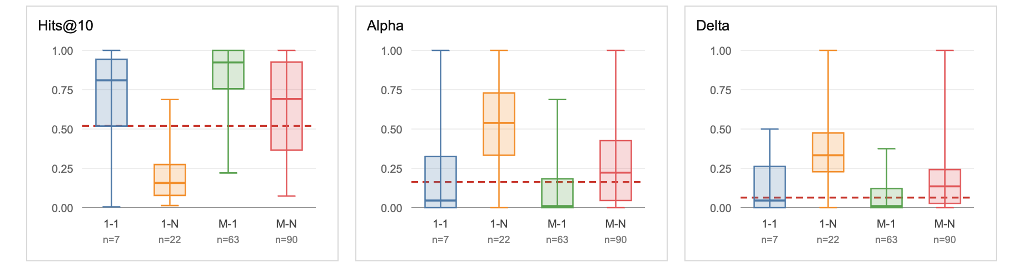

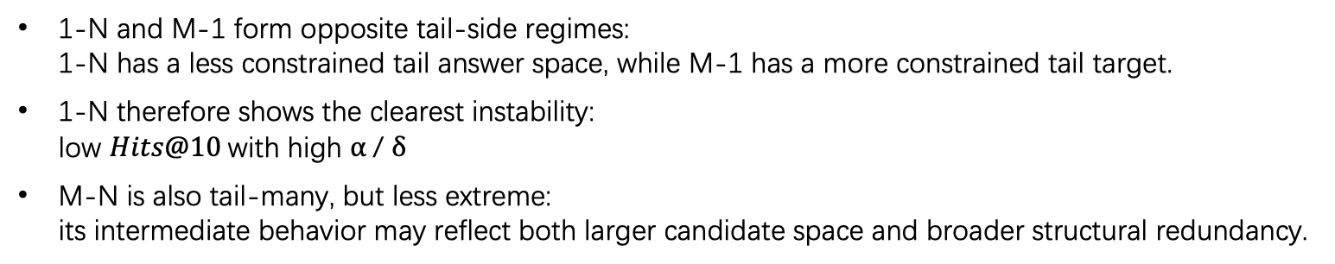
Result 1: Mapping Property Strongly Affects Multiplicity
RotatE tail-side
Query: $\left(h , r , ?\right)$
The red dashed line shows the corresponding result from the original paper.
Key finding: Multiplicity follows the answer-space structure of the relation.
1-N and M-1 form opposite tail-side regimes: 1-N has a less constrained tail answer space, while M-1 has a more constrained tail target.
1-N therefore shows the clearest instability: low $Hits@10$with high $α$/ $δ$
M-N is also tail-many, but less extreme: its intermediate behavior may reflect both larger candidate space and broader structural redundancy.
Notes:
Now I move to the main results. The first result is the mapping property analysis.
This slide shows the result of RotatE on tail prediction. The query form is (h, r, ?), so the model needs to predict the tail entity.
The left plot shows Hits@10, which represents prediction accuracy.
The middle and right plots show alpha and delta, which represent the strength of predictive multiplicity.
Simply speaking, higher alpha and delta mean that the hit or miss decisions are more unstable across repeated runs.
The most important message of this figure is not that one relation type is simply good or bad.
The key point is that tail-side multiplicity follows the answer-space structure of the relation.
For 1-to-N relations, the tail side is the many-side.
This means that for the same (h, r), there may be many plausible tail candidates.
As a result, the top-K boundary around the correct answer is harder to keep stable. Models trained with different random seeds are more likely to disagree on the hit or miss decision.
In the figure, we can see that 1-to-N has the lowest Hits@10, and also the highest alpha and delta.
In contrast, M-to-1 is more constrained on the tail side.
From the viewpoint of tail prediction, the answer space is more concentrated. Therefore, different runs are more likely to form consistent ranking behavior.
As a result, M-to-1 shows the highest Hits@10 and the lowest multiplicity.
We should also look at M-to-N.
M-to-N also includes many-side tail prediction, but it is not as extreme as 1-to-N.
One possible explanation is that M-to-N has both a larger candidate space and broader many-to-many structural support.
Therefore, its behavior is not simply the same as 1-to-N. Instead, it appears as an intermediate case.
So the key message of this slide is that predictive multiplicity is not merely random seed noise.
It is systematically related to relation-level answer-space structure.
接下来进入目前 thesis 里最核心的结果，也就是 mapping property analysis。
这一页展示的是 RotatE 在 tail prediction 上的结果。这里的 query 是 (h, r, ?)，也就是说模型需要预测 tail entity。左边是 Hits@10，表示预测准确性；中间和右边分别是 alpha 和 delta，表示 predictive multiplicity 的强度。简单来说，alpha 和 delta 越高，说明不同 repeated runs 之间的 hit / miss decision 越不稳定。
这张图最重要的结论不是某一个 relation type 单独表现好或坏，而是：
tail-side multiplicity follows the answer-space structure of the relation.
对于 1-N relation，tail side 是 many-side。也就是说，对于同一个 (h, r)，可能存在多个合理的 tail candidates。因此，正确答案附近的 top-K boundary 更难稳定，不同 seed 训练出来的模型更容易在 hit / miss decision 上产生分歧。图中也可以看到，1-N 的 Hits@10 最低，同时 alpha 和 delta 最高。
相反，M-1 在 tail side 上是相对 constrained 的情况。也就是说，从 tail prediction 的角度看，候选答案空间更加集中，模型之间更容易形成一致的 ranking behavior。所以它表现为最高的 Hits@10 和最低的 multiplicity。
这里还需要注意 M-N。它同样包含 many-side tail prediction，但它并没有像 1-N 那样极端。一个可能的解释是，M-N 同时具有更大的候选空间和更广泛的 many-to-many 结构支持。因此，它的行为不是单纯接近 1-N，而是呈现出更中间的状态。
所以这一页的核心信息是：
predictive multiplicity is not merely random seed noise. It is systematically related to relation-level answer-space structure.

Slide 8
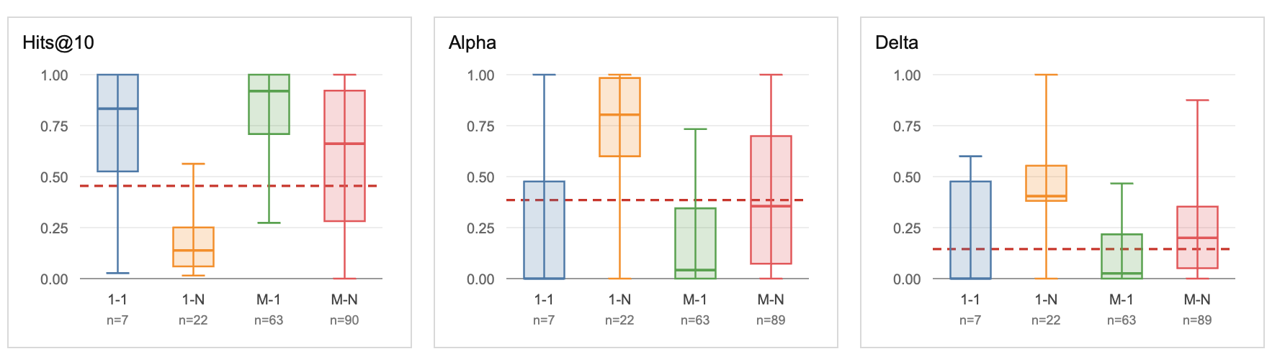
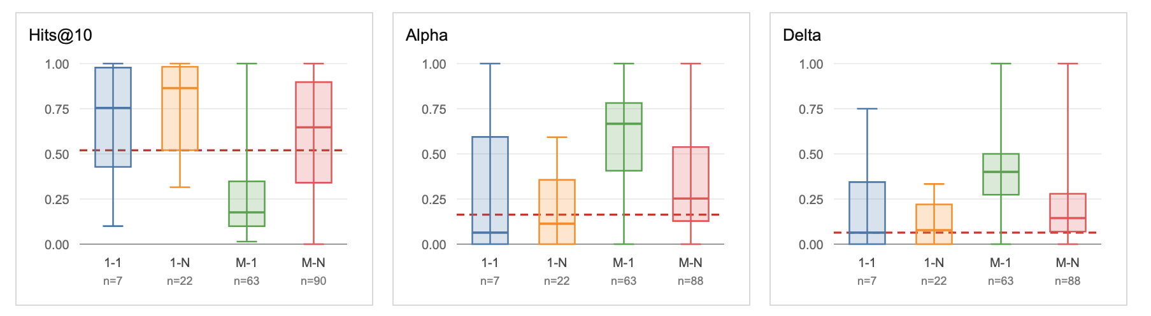


Result 1: Mapping Property Strongly Affects Multiplicity
Cross-model check: TransE tail-side
Query: $\left(h , r , ?\right)$
The same tail-side contrast remains visible in TransE.
M-1 remains the most stable regime, while 1-N remains the most multiplicity-prone regime.
The mapping-property effect is not specific to a single model (RotatE).
The red dashed line shows the corresponding result from the original paper.
Prediction-side check: RotatE head-side
Query: $\left(? , r , t\right)$
The pattern reverses when switching from tail prediction to head prediction.
1-N becomes stable regime, while M-1 becomes the most multiplicity-prone regime.
Multiplicity follows the predicted side, not a fixed mapping-type label.
The red dashed line shows the corresponding result from the original paper.
Notes:
On the previous slide, I used the RotatE tail-side result to explain the main mapping property pattern.
On this slide, I further show that this result is not accidental. There are two kinds of supporting evidence.
The same three metrics are shown here: Hits@10, alpha, and delta.
The first check is cross-model consistency.
Here, I change the model from RotatE to TransE, while still using tail prediction, that is, (h, r, ?).
We can see that the overall trend remains consistent.
M-to-1 remains the most stable regime, while 1-to-N remains the most multiplicity-prone regime.
This suggests that the mapping-property pattern is not specific to RotatE, but also appears in another representative KGE model.
The second check is the prediction-side check.
Here, I return to RotatE, but change the prediction side from tail prediction to head prediction. The query form is (?, r, t).
In this case, we can see an important mirror reversal.
1-to-N becomes the most stable regime, while M-to-1 becomes the most multiplicity-prone regime.
This is important because it shows that the mapping property effect is tied to the prediction side.
When the prediction target lies on the many-side, the candidate answer space is more dispersed, and the top-K boundary is more likely to change.
Therefore, multiplicity becomes stronger.
So the main conclusion of this slide is that the mapping property effect is not a single-model artifact, and it is not only a tail-side phenomenon.
It is a robust and directional relation-level structural pattern.
上一页我先用 RotatE 的 tail-side 主图说明了 mapping property 的核心结果。 这一页我想进一步说明，这个结果不是偶然现象，而是有两个层面的支撑。
The same three metrics are shown here: Hits@10, alpha, and delta.
第一个支撑是 cross-model consistency。 这里我把模型从 RotatE 换成 TransE，但仍然看 tail prediction，也就是 (h, r, ?)。 可以看到，整体趋势仍然保持一致：M-1 仍然是最稳定的 regime，而 1-N 仍然是 multiplicity 最强的 regime。
这说明上一页观察到的 pattern 不是 RotatE 特有的单模型现象，而是在另一个代表性 KGE 模型上也能观察到类似趋势。 也就是说，mapping property 的 effect 不是某个特定 model artifact。
第二个支撑是 prediction-side check。 这里我回到 RotatE，但把 prediction side 从 tail prediction 换成了 head prediction，也就是 (? , r, t)。 这时可以看到一个很重要的 mirror reversal：1-N 变成最稳定的 regime，而 M-1 反而变成 multiplicity 最强的 regime。 因此，mapping property 的 effect 是和 prediction side 绑定的，也就是说，当 prediction target 落在 many-side 时，candidate answer space 更分散，top-K boundary 更容易变化，因此 multiplicity 更强。
所以这一页的核心结论是： mapping property 的 effect 既不是单模型偶然现象，也不是只在 tail-side 才成立的局部现象。 它是一个 robust and directional relation-level structural pattern。

Slide 9
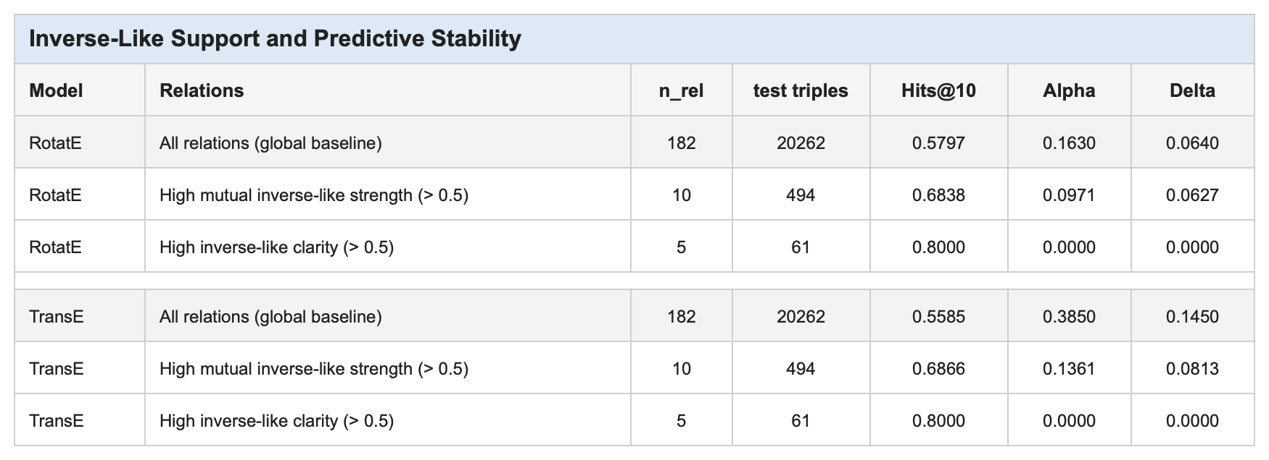
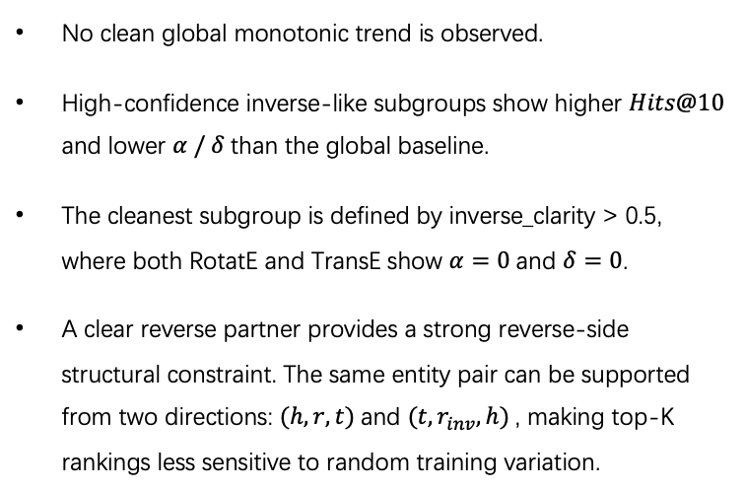
Result 2: High-Confidence Inverse-Like Relations Are More Stable
Key finding
No clean global trend, but high-confidence inverse-like relations form a stable group.
No clean global monotonic trend is observed.
High-confidence inverse-like subgroups show higher $Hits@10$ and lower $α / δ$than the global baseline.
The cleanest subgroup is defined by inverse_clarity > 0.5, where both RotatE and TransE show $α=0$and $δ=0$.
A clear reverse partner provides a strong reverse-side structural constraint. The same entity pair can be supported from two directions: $(h, r, t)$and $(t,r_{inv}, h)$, making top-K rankings less sensitive to random training variation.
mutual_inverse_strength : bidirectional reverse-support strength.
inverse_clarity: confidence that the best reverse partner is clearly distinguishable.
Example
mutual_inverse_strength | = | 0.8026
inverse_clarity (two directions) | = | 0.7770/0.7710
hits@10 | = | 1.0000
alpha | = | 0.0000
delta | = | 0.0000
/education/educational_institution_campus/educational_institution | $$→$$ | institution of the campus
/education/educational_institution/campuses | $$→$$ | campuses of the institution
Notes:
Next, I move to the second result, which is inverse-like support。 The main finding is that inverse-like support is not useful as a broad global trend, but it becomes informative when the reverse partner is strong and clearly identifiable. In this case, high-confidence inverse-like relations form a stable group with higher Hits@10 and lower alpha and delta.
Here, I use two metrics.
The first one is mutual_inverse_strength.
It measures whether two relations provide reverse support for each other in the training graph.
More specifically, after reversing the edges of one relation, it checks whether those reversed edges are covered by another relation.
The second metric is inverse_clarity.
It measures whether the best reverse partner is clearly better than the other candidate relations.
In other words, it does not only ask whether there is some reverse overlap.
It asks whether the inverse-like partner is clearly identifiable.
From the table, we can see that compared with the global baseline, high-confidence inverse-like relation sets show higher Hits@10 and lower alpha and delta.
In particular, for the relation set with inverse_clarity greater than 0.5, both RotatE and TransE reach alpha = 0 and delta = 0.
This means that the top-K hit or miss decisions are very consistent across repeated runs for these relations.
My interpretation is that when a relation has a clear reverse partner, the training graph supports the same kind of entity pair from two directions: (h, r, t) and (t, r_inv, h).
This reverse-side structural constraint makes it easier for the model to learn consistent ranking behavior.
As a result, the top-K decision is less sensitive to random seed variation.
The education relation pair at the bottom is an intuitive example.
educational_institution_campus / educational_institution means the institution of the campus.
educational_institution / campuses means the campuses of the institution.
This is a semantically clear inverse-like pair.
Its mutual_inverse_strength is 0.8026, and its inverse_clarity is about 0.77.
The prediction result is also very stable. Hits@10 is 1.0000, while alpha and delta are both 0.
So the main conclusion of this slide is that inverse-like support is not a global explanatory factor like mapping property.
However, it can identify a small group of very stable high-confidence inverse-like relations.
接下来是第二个结果，也就是 inverse-like support。
这一部分和前面的 mapping property 不一样。Mapping property 给出了比较清楚的 directional structural pattern，但 inverse-like support 并没有形成一个
强的全局规律。这里我更谨慎地把它理解为一个 high-confidence local stability signal：只有当 reverse partner 足够强、也足够清晰时，才会出现稳定的预测
行为。
这里我使用两个指标。
第一个是 mutual_inverse_strength，表示两个 relation 在训练图中是否能彼此提供反向支持。也就是说，把一个 relation 的边反过来之后，能否被另一个
relation 覆盖。
第二个是 inverse_clarity，表示这个 best reverse partner 是否明显优于其他候选 relation。换句话说，它衡量的不是“有没有一点 reverse overlap”，而是这
个 inverse-like partner 是否足够明确。
从表格可以看到，和 global baseline 相比，high-confidence inverse-like relation sets 表现出更高的 Hits@10 和更低的 alpha / delta。
特别是 inverse_clarity > 0.5 的 relation set，在 RotatE 和 TransE 中都达到 alpha = 0 和 delta = 0。这说明这些 relation 上 repeated runs 的 top-K
hit/miss decision 非常一致。
我的解释是，当一个 relation 有清晰的 reverse partner 时，训练图实际上从两个方向支持同一类 entity pair：(h, r, t) 和 (t, r_inv, h)。这种 reverse-
side structural constraint 会让模型更容易学习到一致的 ranking behavior，因此 top-K decision 对 random seed 的变化没有那么敏感。
下面这个 education relation pair 是一个直观例子。
educational_institution_campus / educational_institution 表示 campus 所属的 institution；
educational_institution / campuses 表示 institution 拥有的 campuses。
这是一组语义上很清楚的 inverse-like pair。它的 mutual_inverse_strength = 0.8026，inverse_clarity 也大约是 0.77。对应预测结果中，Hits@10 = 1.0000，
同时 alpha = 0、delta = 0。
所以这一页的核心结论是：
inverse-like support 不是像 mapping property 那样的全局解释因素，但它可以识别出一小部分非常稳定的 high-confidence inverse-like relations。

Slide 10
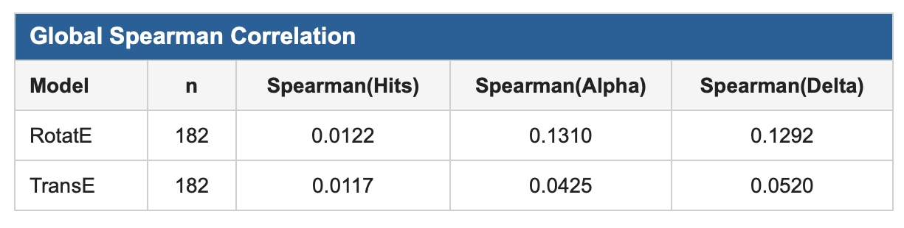
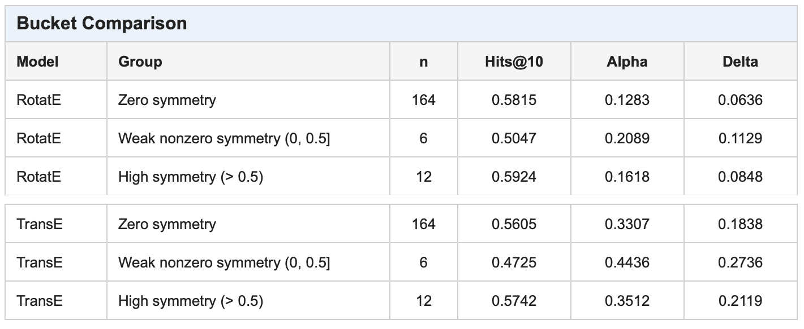
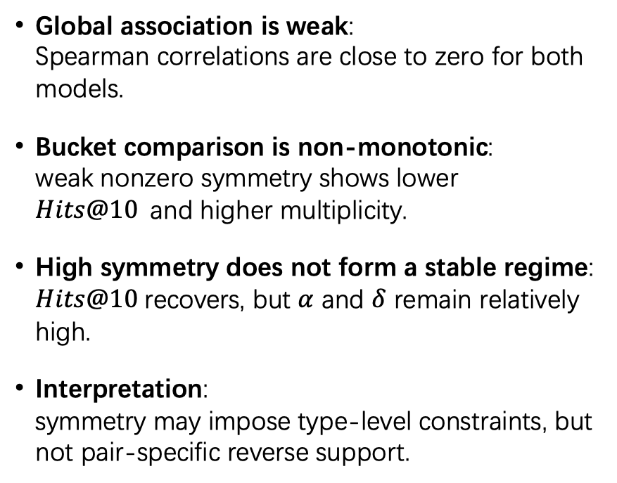
Result 3: Symmetry Alone Does Not Define a Stable Regime
Global check: weak Spearman correlations
Global association is weak: Spearman correlations are close to zero for both models.
Bucket comparison is non-monotonic: weak nonzero symmetry shows lower $Hits@10$and higher multiplicity.
High symmetry does not form a stable regime: $Hits@10$recovers, but $α$ and $δ$ remain relatively high.
Interpretation: symmetry may impose type-level constraints, but not pair-specific reverse support.
Bucket check: high-symmetry group is not more stable
Notes:
The third result is about symmetry.
The main finding is that symmetry alone does not define a stable regime.
Although symmetry is a reasonable structural candidate, the results show that it is not sufficient to explain predictive multiplicity by itself.
First, the global Spearman correlations are weak.
For both RotatE and TransE, the correlations between the symmetry score and Hits@10, alpha, and delta are all close to zero.
This means that, at the global relation level, symmetry is not strongly associated with either prediction accuracy or multiplicity.
Next, I look at the bucket comparison.
Relations are divided into three groups: zero symmetry, weak nonzero symmetry, and high symmetry.
Rather than a simple trend where higher symmetry leads to lower multiplicity, the current result looks more like a two-end pattern.
The zero-symmetry group and the high-symmetry group show relatively higher Hits@10, while the weak nonzero symmetry group shows lower Hits@10 and higher multiplicity.
So, the main point is not that high symmetry is clearly stable or unstable.
One possible interpretation is that symmetry provides only a coarse constraint.
For example, a symmetric relation may suggest that the head and tail entities come from similar semantic types, such as person-person or location-location.
This type-level constraint may help with rough filtering, but it does not necessarily identify the correct entity for a specific query.
If many candidate entities have similar types, the competition inside the top-K ranking can still be strong.
As a result, the top-K boundary can still change across repeated runs.
In short, symmetry alone is not enough to stabilize top-K decisions.
接下来这一页是 symmetry 的结果。
和前面的 mapping property 以及 inverse-like support 不同，这里我们没有观察到一个很清楚的 stability pattern。 更具体地说，我们没有看到 symmetry 越高，predictive multiplicity 就越低的稳定单调趋势。
首先看上面的 global Spearman correlation。 无论是 RotatE 还是 TransE，symmetry score 和 Hits@10、alpha、delta 之间的相关性都比较弱，整体上接近于 0。 这说明，从全局 relation-level 的角度来看，symmetry 本身并不能很好地解释 prediction accuracy 或 predictive multiplicity 的变化。
然后看下面的 bucket comparison。 这里我把 relation 分成 zero symmetry、weak nonzero symmetry，以及 high symmetry 三组。 如果 symmetry 是一个强的 standalone stability factor，我们本来可能期待：symmetry 越高，alpha 和 delta 越低。
但是结果并不是这样。 Bucket comparison 没有呈现出清楚的单调趋势。weak nonzero symmetry group 的 Hits@10 反而较低，同时 alpha 和 delta 更高。这里需要注意这个 group 的样本数比较小，所以我不会把这一点解释得过强。更稳妥的结论是：这个 bucket comparison 没有支持 “symmetry 越高越稳定” 这个假设。
进一步看 high symmetry group，它的 Hits@10 确实有所恢复，但是 alpha 和 delta 并没有低于 zero-symmetry baseline。 也就是说，high-symmetry relations 并没有形成一个 clean low-multiplicity regime。
我对这个结果的理解是：symmetry 可能提供的是一种比较粗粒度的 bidirectional 或 type-level constraint。 例如，一个 symmetric relation 往往意味着 head 和 tail 可能来自相似的语义类型，比如人物和人物、地点和地点，或者同类概念之间的关系。 这种约束可能有助于模型进行粗粒度筛选。
但是，这种 type-level 或 coarse bidirectional constraint 并不一定能告诉模型：在具体 query 中，哪一个 entity 才应该稳定地排在 top-K 里面。 如果候选实体本身都来自相似类型，那么 candidate competition 仍然可能很强，top-K boundary 仍然可能受到 random seed 或训练扰动的影响。
所以这一页的结论是：symmetry 是一个合理的 candidate factor，但在当前 setting 下，它并不是一个 strong standalone explanatory factor。 换句话说，symmetry alone does not define a stable regime。

Slide 11
Summary & Future Work
Summary
Predictive multiplicity shows relation-level structural heterogeneity.
Mapping property provides the strongest and most directional signal: multiplicity follows the predicted side of the relation.
High-confidence inverse-like pairs form a locally stable group, but inverse-like support is not a clean global factor.
Symmetry alone does not define a stable regime.
Overall, predictive multiplicity should be analyzed not only as a global model-level phenomenon, but also through relation-level structural factors.
Future work
Relation frequency as a control factor Examine whether the mapping-property effect remains after controlling for relation support and sparsity.
Broader validation Extend the analysis to more datasets and additional KGE model families.
From diagnosis to mitigation Use relation-level instability signals to design targeted voting or adaptive ensemble strategies.
Notes:
Finally, I will summarize the current results and discuss possible future work.
First, predictive multiplicity is not only a phenomenon at the whole-model or whole-dataset level.
Through relation-level analysis, we can see that it appears more strongly in some relations than in others.
Among the candidate factors, mapping property gives the clearest result.
When the prediction target is on the many-side, the answer space is larger, the top-K boundary is less stable, and multiplicity becomes stronger.
The second result is inverse-like support.
Globally, we do not observe a clear trend where stronger inverse-like support always leads to lower multiplicity.
However, when the reverse partner is strong and clear, high-confidence inverse-like pairs can form a locally stable subgroup.
So inverse-like support is useful mainly as a local stability signal.
The third result is symmetry.
Symmetry is an intuitive candidate factor because it represents bidirectional support within the same relation.
However, in the current experiments, symmetry alone does not define a clean stable regime.
It may provide some type-level or coarse structural constraint, but this is not enough to stabilize top-K rankings for specific queries.
Overall, the current conclusion is that predictive multiplicity should not be analyzed only as a global model-level phenomenon.
Next, I will discuss future work.
The first direction is relation frequency as a control factor.
In the current analysis, I have included relation frequency as a support and sparsity factor.
The next step is to examine more strictly whether the mapping-property effect remains after controlling for relation support and sparsity.
This is important because it can help confirm that the observed mapping-property effect is not simply caused by data-size differences.
The second direction is broader validation.
At this stage, the experiments mainly focus on FB15k-237, and on two models: RotatE and TransE.
In the future, I need to extend the analysis to more datasets and more KGE model families.
If similar directional patterns appear across different datasets and models, the relation-level structural explanation will become more convincing.
The third direction is from diagnosis to mitigation.
The current work is mainly diagnostic.
It identifies which relation structures show stronger predictive multiplicity. The next step is mitigation. For example, relation-level instability signals could be used to design targeted voting or adaptive ensemble methods. Instead of treating all relations in the same way, we can focus more on relations that are more likely to be unstable.
最后，我总结一下目前为止的结果，以及接下来可以继续推进的方向。
首先，从整体上看，predictive multiplicity 并不是一个只存在于整个模型或者整个数据集层面的现象。 通过 relation-level analysis 可以看到，它在不同 relation 上的表现并不均匀，也就是说，predictive multiplicity 具有明显的 relation-level structural heterogeneity。
在目前考察的几个 candidate factors 中，最清楚、最有方向性的结果来自 mapping property。 它描述的是一个 relation 在 head side 和 tail side 上的 cardinality structure，例如 1-1、1-N、M-1 和 M-N。 实验结果显示，multiplicity 并不是简单地固定在某一个 mapping label 上，而是和 prediction side 绑定在一起。 也就是说，当 prediction target 落在 relation 的 many-side 时，answer space 更分散，top-K boundary 更容易不稳定，因此 multiplicity 更强。
第二个结果是 inverse-like support。 和 mapping property 不同，inverse-like support 没有形成一个 clean global factor。 也就是说，全局上我们没有观察到 inverse-like support 越强，multiplicity 就越低的稳定单调关系。 但是，当 reverse partner 足够强、也足够清晰时，high-confidence inverse-like pairs 会形成一个局部稳定的 subgroup。 这说明 inverse-like support 更适合作为一个 local stability signal，而不是全局解释因素。
第三个结果是 symmetry。 Symmetry 在直觉上是一个合理的 candidate factor，因为它表示同一个 relation 内部是否存在 bidirectional support。 但是在当前实验中，symmetry alone 并没有定义出一个 clean stable regime。 它可能提供一些 type-level 或 coarse bidirectional constraint，但这种约束不足以稳定具体 query 上的 top-K ranking。
所以总体来说，我目前得到的结论是： predictive multiplicity 不应该只被看作一个 global model-level phenomenon。 它也应该通过 relation-level structural regimes 来分析。 换句话说，我们不仅要问“这个模型整体有没有 multiplicity”，还需要进一步问：“这种 instability 在哪些 relation structure 上更严重”。
接下来是 future work。
第一点是 relation frequency as a control factor。 目前我已经把 relation frequency 作为 support / sparsity factor 纳入考虑，但下一步还需要更严格地检查：mapping property 的 effect 在控制 relation support 和 sparsity 之后是否仍然存在。 这一步很重要，因为它可以帮助确认目前观察到的 mapping-property effect 不是简单由数据量差异造成的。
第二点是 broader validation。 目前实验主要集中在 FB15k-237，以及 RotatE 和 TransE 这两个模型上。 之后需要扩展到更多 datasets 和更多 KGE model families。 如果类似的方向性结果在不同数据集和模型中都能观察到，那么这个 relation-level structural explanation 会更有说服力。
第三点是 from diagnosis to mitigation。 目前的工作更偏向 diagnosis，也就是识别 multiplicity 在哪些 relation structure 上更严重。 但如果我们已经知道某些 relation-level signals 会对应更高 instability，那么下一步就可以考虑 mitigation。 例如，可以根据 relation-level instability 设计 targeted voting，或者 adaptive ensemble strategies。 也就是说，不是对所有 relation 使用同样的 ensemble 或 voting 方法，而是对更容易不稳定的 relation 进行更有针对性的处理。
所以，这一页的最终总结是： 目前的结果说明，predictive multiplicity 在 KGE link prediction 中不仅是一个整体性能层面的问题，它还和 relation-level structure 有系统性的关联。 后续工作可以沿着更严格的 control analysis、更广泛的验证，以及从诊断到缓解这三个方向继续推进。

Slide 12
Reference
[1] Lv, Yana, and Haomiao Bao. “NSE-KGC: A Knowledge Graph Completion Method Based on Neighborhood Semantic Evidence.” In 2024 5th International Conference on Big Data & Artificial Intelligence & Software Engineering (ICBASE), 287–90, 2024.
[2] Zhu Y, Potyka N, Nayyeri M, et al. Predictive multiplicity of knowledge graph embeddings in link prediction[C]. Findings of the Association for Computational Linguistics: EMNLP 2024. 2024: 334-354.
[3] Sun Z, Deng Z H, Nie J Y, et al. Rotate: Knowledge graph embedding by relational rotation in complex space[J]. arXiv preprint arXiv: 1902. 10197, 2019.
[4] Bordes A, Usunier N, Garcia-Duran A, et al. Translating embeddings for modeling multi-relational data[J]. Advances in neural information processing systems, 2013, 26.

Slide 13
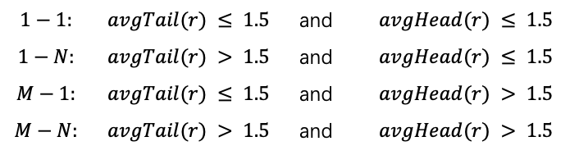
A. Theoretical Setting
Mapping Property
Symmetry
Relation edge set
Edge set:
Symmetric-supported edge set:
Average tail connectivity:
Raw symmetry score:
Average head connectivity:
To remove self-loop inflation, the main metric excludes edges with h = t.
Excluding-self edge set:
Classification rule:
$$1−1:$$ | $$avgTail(r) ≤ 1.5$$ | and | $$avgHead(r) ≤ 1.5$$
$$1−N:$$ | $$avgTail(r) > 1.5$$ | and | $$avgHead(r) ≤ 1.5$$
$$M−1:$$ | $$avgTail(r) ≤ 1.5$$ | and | $$avgHead(r) > 1.5$$
$$M−N:$$ | $$avgTail(r) > 1.5$$ | and | $$avgHead(r) > 1.5$$
Main symmetry score:

Slide 14
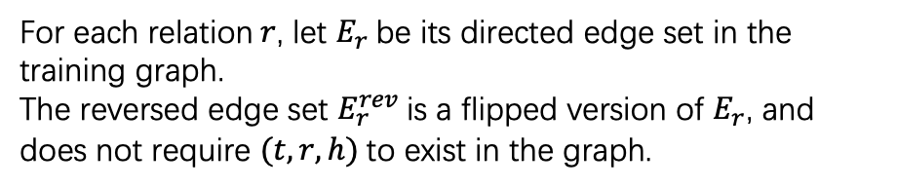
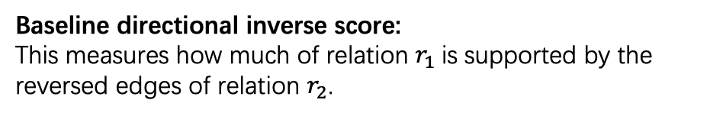
A. Theoretical Setting
Inverse
For each relation$r$, let $E_{r}$ be its directed edge set in the training graph. The reversed edge set $E_{r}^{rev}$ is a flipped version of $E_{r}$, and does not require $(t,r,h)$to exist in the graph.
Mutual inverse strength: For each relation, we keep the strongest mutual inverse-like partner.
Inverse clarity: This measures whether the best inverse-like partner is clearly better than the second-best candidate.
Baseline directional inverse score: This measures how much of relation $r_{1}$is supported by the reversed edges of relation $r_{2}$.
Mutual inverse score:

Slide 15
第4页
Research Focus: From Prior Work to My Thesis Question
第5页
Method: Thesis Setting and Relation-Level Analysis Pipeline
第6页
Method: Relation-Level Factors Under Study
第7页
Method Insight: Why By-Side Analysis Is Necessary
第8页
Main Result: Mapping Type (RotatE)
第9页
Main Result: Mapping Type (TransE Replication)
第10页
Secondary Result: Inverse-Like Support
第11页
这个如果你把 symmetry 和 frequency 放一页，我建议分两块：
Negative Result: Symmetry
Control Analysis: Relation Frequency
Additional Findings: Symmetry and Relation Frequency
Conclusion: Main Findings and Current Thesis Positioning

Slide 16


Prior Work: Predictive Multiplicity
Predictive multiplicity^{[2]}
Top-K hit / miss decision for one query-answer pair
Even when models have similar overall performance, they may still disagree on whether a specific query is a top-K hit or miss.
By quantified by ambiguity and discrepancy.
Query-level disagreement
Ambiguity: among all test queries, how many receive at least one conflicting decision?
Discrepancy: for one competing model, how large can the overall disagreement rate be?
Ambiguity
Example
Test Triples (optimal decision)
Discrepancy
<CompanyA, has_supplier, SupplierA>
<CompanyB, has_supplier, SupplierB>
Query for Model 1, 2:
<CompanyA, has_supplier, ?>
<CompanyB, has_supplier, ?>
Model 1 Prediction ($50\%$ correct)
Model 2 Prediction ($50\%$correct)
<CompanyA, has_supplier, SupplierA>
<CompanyB, has_supplier, SupplierA>
<CompanyA, has_supplier, SupplierB>
<CompanyB, has_supplier, SupplierB>
Notes:
在上一页里，我先介绍了 link prediction 和 Hits@10。 在这个基础上，我们进一步考虑一个问题：如果对同一个 KGE 模型 family 用不同随机种子做 repeated runs，那么这些模型对同一个 query 的 top-10 hit / miss 判定，会不会始终一致？
Predictive multiplicity 讨论的就是这里的一种 query-level 不稳定性。 也就是说，即使几个模型的整体表现差不多，它们对于同一个 query，仍然可能在 top-K 的 hit / miss 判定上出现分歧。
这件事之所以值得关注，是因为：整体 accuracy 接近，并不代表单个 query 上的决策也是一致的。 原论文也特别指出，如果 link prediction 被用于下游决策，那么这种 query-level 的不稳定性可能会带来实际风险，尤其是在高风险应用场景中。
例如这里这个 toy example 里，对于同一个 query，一个模型把正确答案排在前10内，所以这是一个 hit@10；但另一个模型把正确答案排在第10名之外，所以就是 miss@10。 这说明：虽然模型 family 相同，整体表现也可以接近，但 prediction 在 query level 上并不一定稳定。
为了更严格地描述这种现象，论文先把 top-K success 写成一个二值判定：如果正确答案进入前 K 名，那么记为 1，否则记为 0。 在这个基础上，再定义 query-level disagreement，也就是：一个 competing model 和 baseline model 对同一个 query 的 hit / miss 判断是否不同。
接下来，论文用两个指标来刻画这种 multiplicity。 Ambiguity 看的是：在所有测试 query 里，有多少 query 至少出现过一次这种冲突。 Discrepancy 看的是：对于某一个 competing model，它和 baseline 之间，整体最多能分歧到什么程度。
所以后面我做 relation-level analysis 时，本质上就是在问：这种 query-level instability，会不会在某些 relation structure 上更加明显。

Slide 17
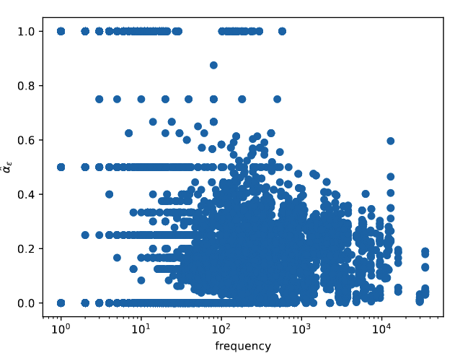
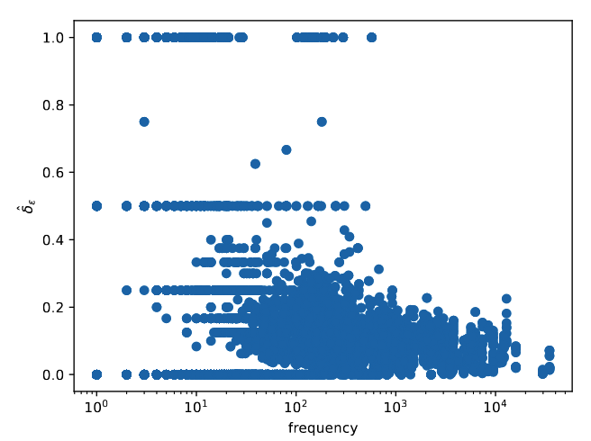


Method: Candidate Relation-Level Factors
Mapping type
Symmetry
How many distinct heads/tails are typically associated with a relation.
Whether $(h,r,t)$is often supported by $(t,r,h)$ under the same relation.
Typical categories
Intuition
$1−1$, $1−N$, $M−1$, $M−N$
Another plausible candidate because internal bidirectional support may affect uncertainty.
Intuition
Example
A plausible candidate because reverse structural support may constrain prediction behavior.
married_to
adjacent_to
Example
capital_of: closer to 1-1
born_in: closer to M-1
language_spoken_in: can look more M-N
Relation frequency (Support/ sparsity factor)
How often a relation appears in the training graph.
Included as a support/sparsity control variable.
Inverse
Intuition
Whether a relation has a clear reverse partner.
Partly motivated by the weak negative relation reported in the original paper.
Intuition
These figures^{[2]} demonstrates the weak negative correlation between relation frequency and empirical ambiguity/ discrepancy.
If a relation is strongly supported by a reverse relation, repeated runs may learn more consistent behavior
Example
parent_of $⇔$child_of
capital_of $⇔$has_capital
Notes:
接下来我说明一下，在 relation-level 上，我选取了哪些候选因素来分析 predictive multiplicity。 这里我并不是把它们当作已经成立的规律，而是把它们看作 值得检验的 candidate factors。
第一类是 mapping type，也就是一个 relation 在 head 和 tail 两侧通常呈现怎样的连接形态，比如 1-1、1-N、M-1 和 M-N。 之所以考虑它，是因为这种连接结构本身就可能影响 prediction difficulty，而且这种影响很可能具有方向性。
第二类是 inverse-like support。 这里想刻画的是：一个 relation 是否存在比较清晰的 reverse partner。 直觉上，如果一个 relation 在训练图中有更明确的反向支持，那么 repeated runs 可能更容易学出相对一致的 behavior，所以它是一个值得检验的结构因素。
第三类是 symmetry。 它描述的是：对于同一个 relation，(h,r,t) 是否常常也会在同一 relation 下看到 (t,r,h)。 也就是说，它反映的是 relation 内部的一种双向支持结构，因此也可以作为一个候选解释因素来考察。
除了这些 structural factors 之外，我还单独加入了 relation frequency。 它不属于 relation pattern，而是一个 support / sparsity factor。 我把它纳入进来，一方面是因为原论文提到 relation frequency 和 multiplicity 之间存在一个比较弱的负相关趋势；另一方面，也是希望把它作为一个 control variable，去检查后面的结构结果是否只是简单的 support 差异造成的。

Slide 18
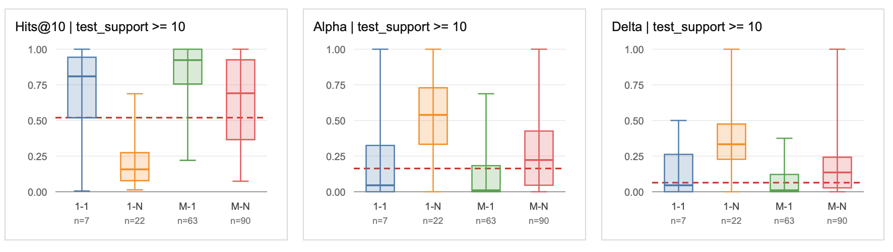
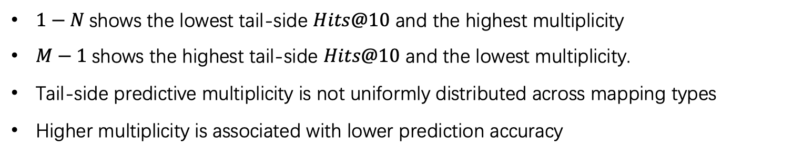

Main Result: Mapping Property Strongly Affects Multiplicity
RotatE tail-side
Query: $\left(h , r , ?\right)$
Only relations with test_support >= 10 are shown.
The red dashed line shows the corresponding result from the original paper.
$1−N$shows the lowest tail-side $Hits@10$ and the highest multiplicity
$M−1$shows the highest tail-side $Hits@10$ and the lowest multiplicity.
Tail-side predictive multiplicity is not uniformly distributed across mapping types
Higher multiplicity is associated with lower prediction accuracy
Notes:
接下来进入我当前 thesis 里最核心的结果，也就是 mapping type。 这里我先展示 RotatE 在 tail prediction 上 的主结果，因为这一张图最能直接体现我们观察到的结构性差异。
这张图最重要的信息是：predictive multiplicity 并不是在不同 mapping type 上均匀分布的。 也就是说，relation structure 不是一个无关背景，而是会系统性地对应不同程度的 instability regime。
更具体地看，在 tail-side 上，1-N 的 Hits@10 最低，同时 multiplicity 最高；相反，M-1 的 Hits@10 最高，而 multiplicity 最低。
通过实验我们可以得知，这说明 mapping type 确实划分出了不同的 instability regime。
其中1-N 的 tail-side 仍然表现出更高 multiplicity，说明many-side mapping regime 本身更容易带来 tail-side ranking instability 而且在这个 tail-side 视角下，更容易出现 multiplicity 的 regime，同时也往往具有更低的 prediction accuracy。

Slide 19
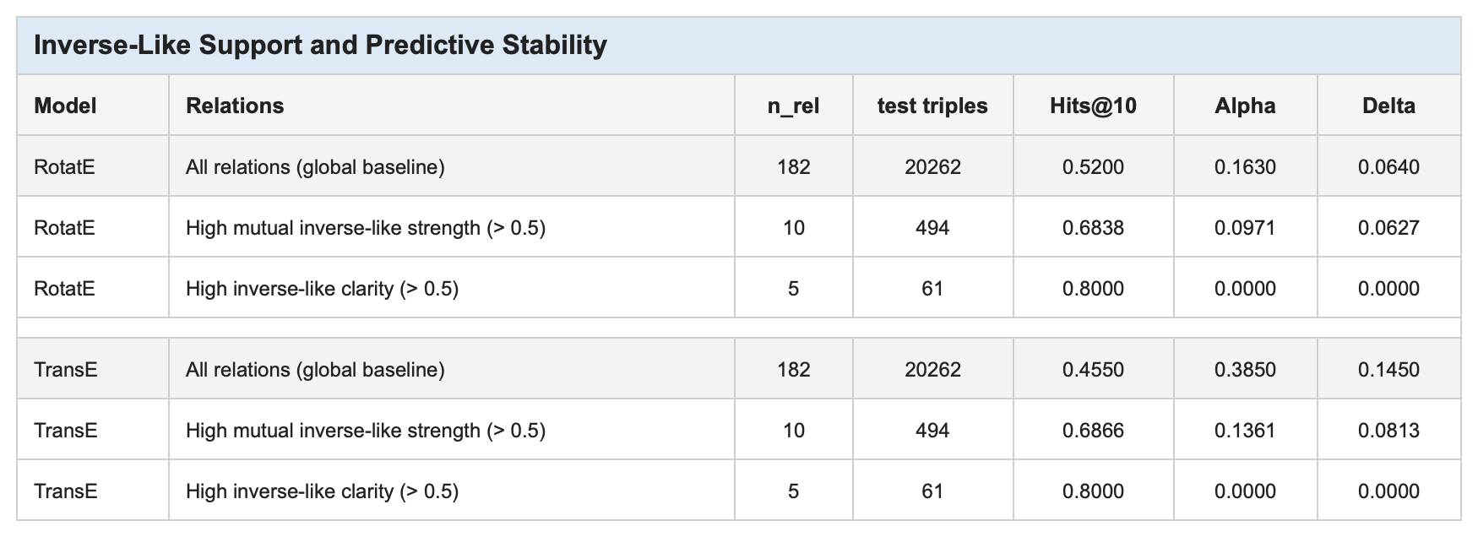
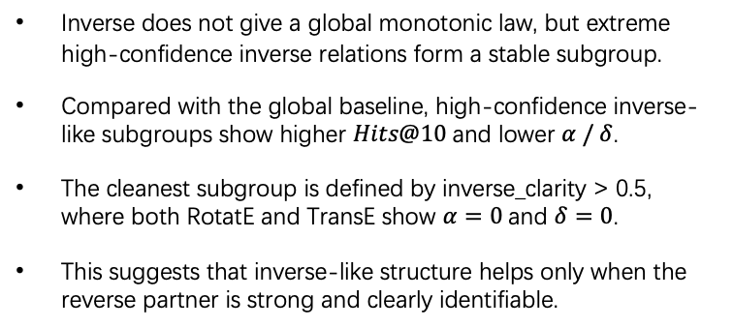
Main Result 2: High-Confidence Inverse-Like Relations Are More Stable
Inverse does not give a global monotonic law, but extreme high-confidence inverse relations form a stable subgroup.
Compared with the global baseline, high-confidence inverse-like subgroups show higher $Hits@10$and lower $α / δ$.
The cleanest subgroup is defined by inverse_clarity > 0.5, where both RotatE and TransE show $α=0$and $δ=0$.
This suggests that inverse-like structure helps only when the reverse partner is strong and clearly identifiable.
mutual_inverse_strength : Strength. Measuring how strongly a relation and its best reverse partner support each other in both directions.
inverse_clarity: Uniqueness/ confidence. Measuring whether the best inverse-like partner is clearly better than the other candidates.
Example
mutual_inverse_strength | = | 0.8026
inverse_clarity | = | 0.7700
hits@10 | = | 1.0000
alpha | = | 0.0000
delta | = | 0.0000
/education/educational_institution_campus/educational_institution | $$→$$ | institution of the campus
/education/educational_institution/campuses | $$→$$ | campuses of the institution
Notes:
“这一部分和 mapping type 不一样，它没有形成一个很强的全局规律。我们更稳妥的结论是：全局上，inverse-like support 和 multiplicity 之间没有出现
明显、稳定的单调关系。但是当 inverse-like support 足够高时，会出现一个比较干净的小 subgroup。
这里我主要保留了两种 high-confidence 条件。mutual_inverse_strength 可以理解为两个 relation 彼此作为反向 partner 的强度；inverse_clarity 则是
看这个 partner 是否足够明确。
从这个表里可以看到，不管是 RotatE 还是 TransE，这些 high-confidence subgroup 的 Hits@10 都比较高，而 Alpha 和 Delta 都比较低。所以 inverse
不是全局 explanatory factor，它没有给出全局规律，但确实识别出了一小部分更稳定的 high-confidence inverse-like relations。”
一个很直观的例子是这组 education relation：educational_institution_campus / educational_institution 和 educational_institution / campuses。
这两个 relation 彼此的 inverse-like support 非常强，而且它们的预测表现也非常稳定：Hits@10 很高，同时 Alpha 和 Delta 都非常低。

Slide 20
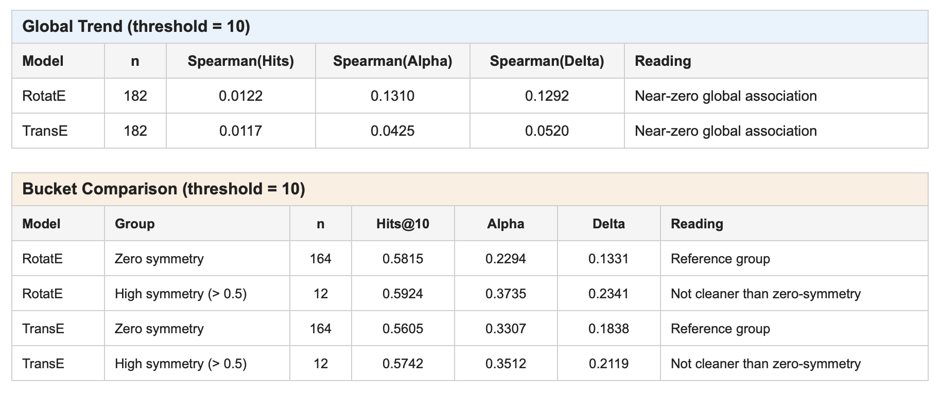
Main Result 3: Symmetry Alone Does Not Define a Stable Regime
Global check: weak Spearman correlations
Bucket check: high-symmetry group is not more stable
In both RotatE and TransE, the global symmetry-multiplicity association remains weak.
High-symmetry relations do not form a clean low-multiplicity subgroup.
Symmetry is not supported as a strong standalone explanatory factor in the current thesis setting.
Notes:
接下来我们看 symmetry。我们把 symmetry 也作为一个候选的 relation-level factor 来检验，想看更强的对称性是否会对应更低的 predictive
multiplicity。结果显示，在 RotatE 和 TransE 两个模型下，symmetry 和 multiplicity 的全局关联都比较弱。进一步看 high-symmetry relations，它们
也没有形成一个像 inverse 那样更稳定、更低 multiplicity 的 subgroup。也就是说，在当前 thesis setting 下，symmetry 不能作为一个强的独立解释因素。

